Slide 1
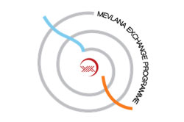
MEVLANA EXCHANGE PROGRAMME

Slide 2
Who Is mevlana?
The original name of Mevlana, from whom the name of the programme is inspired, is Muhammed Celaleddin. Mevlana was born in 1207 in Belh of Horasan distinct that is now in the border of Afghanistan.
Mevlana lived in the 13th century, but as a sufi who got beyond the ages with his works, did not make any discrimination between people as indicated in his verse “Come, come whoever you are”.

Slide 3
Who Is mevlana?
He is accepted worldwide as an intellectual with his point of view to the people and life. UNESCO, due to the 800th anniversary of Mevlana’s birth, declared the year 2007 as Mevlana and Tolerance year.
He is known as Rumi by the western people.

Slide 4
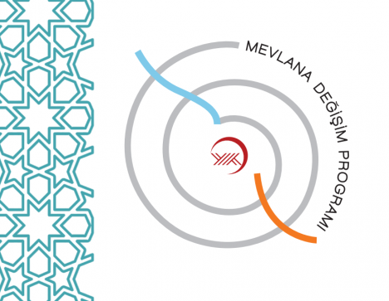
What Is Mevlana exchange programme?
Mevlana Exchange Programme is a programme which aims the exchange of students and academic staff between the Turkish higher education institutions and higher education institutions of other countries.
The programme includes all higher education institutions throughout the world without discriminating between the geographical borders.

Slide 5
Students may study abroad for one (minimum) or two (maximum) terms and academic staff may lecture abroad from one week (minimum) to three months (maximum). Accordingly, students and academic staff from any country may benefit from this programme being hosted by Turkish higher education institutions in order to study or lecture.
The higher education institutions of EU countries benefiting from Erasmus programme are not included in Mevlana Exchange Programme.

Slide 6
The Objectives of Mevlana Exchange Programme
The primary objective of Mevlana Exchange Programme is to exchange students and academic staff between the Turkish higher education institutions and higher education institutions of other countries.

Slide 7
Mevlana Exchange Programme aims;
Making Turkey a centre of attraction in higher education area,
Increasing the academic capacity of Turkish higher education institutions,
Contributing to the globalization process of higher education,
Sharing the historical and cultural heritage of Turkey in a global scale, Enriching the culture of respect and tolerance to differences by increasing intercultural interaction.

Slide 8
Who can benefit from Mevlana Exchange Programme?
The students registered in formal education programmes in Associate Degree, B.A, M.A and PhD level at higher education institutions in Turkey (on condition that the higher education institutions signed a bilateral Mevlana Exchange Protocol) may benefit from Mevlana Exchange Programme.
Additionally, all academic staff who work in a national or foreign higher education institution, on condition that the higher education institutions signed a bilateral Mevlana Exchange Protocol, may benefit from Mevlana Exchange Programme.

Slide 9
Application requirements for students
The requirements for being a Mevlana Exchange Programme Student are;
to be studying at associate degree, bachelor degree, master degree or PhD degree of higher education programmes,
Grade point average (GPA) of associate degree and undergraduate students must be at least 2,5 on a four point scale,
Grade point average (GPA) of graduate students (MA, PhD) must be at least 3.00 on a four point scale,
50% language score + 50% GPA
The students studying in their first year at associate or bachelor degree and the students of preparation classes and scientific preparation programmes of graduate degrees can not participate in this programme at their first semester.

Slide 10
Application requirements for academIc staff
There is no application requirement for academic staff, but academic staff must have enough English language knowledge to give lectures.
In the scope of mobility, academic activities of academic staff can not be less than total six hours weekly.
In hourly calculation of the activities performed by academic staff, courses are considered. If course hours do not complete six hours, academic activities like seminars, panels or conferences are evaluated in this context.
Academic staff mobility plans which do not contain lectures shall not be considered within Mevlana Exchange Programme and accepted for the Exchange.

Slide 11
How to apply?
The students may apply to the Mevlana Exchange Programme unit of his/her university after filling the required forms in https://mevlana.yok.gov.tr properly.
All academic staff, working in higher education institutions with Mevlana Exchange Protocol, may also apply to Mevlana Exchange Programme coordination offices of their institutions.

Slide 12
How many times and how long can we participate in Mevlana Exchange Programme?
Students may study abroad for one (minimum) or two (maximum) semesters. Semester periods may be different considering the education systems but the total exchange period can not exceed one academic year.
Academic staffs also may participate in Mevlana Exchange Programme. Academic staff may lecture abroad from one week (minimum) to three months (maximum).

Slide 13
Do students have to pay any tuition fee when they participate in Mevlana Exchange Programme?
Students do not pay any tuition fees to the host institution during the programme, but they continue to pay the obligatory tuition fees to their home institutions. They do not pay any extra fee to the host institution within the scope of the exchange programme.

Slide 14
Do the students who participate in the programme repeat the courses/semesters taken at the host institution?
As the course(s) to be taken in the host institution are officially agreed to be counted in advance within the Learning Protocol, the students do not repeat any courses/semesters when they return.

Slide 15
Scholarshıps Durıng the Mevlana Exchange Programme
Mevlana Exchange Programme students continue to take their other scholarships and grants in their home countries and they have to do registration in their home institutions. They pay tuition fee to their home institution if they are supposed to and they do not pay any other tuition fee to the host institution.
The scholarship amount to be paid to the Mevlana Exchange students differs according to the life standards of the country of the host institution.

Slide 16
Incoming students from other countries to Turkish higher education institutions are granted according to the ratios determined by Council of Higher Education Executive Board.
In terms of the scholarships that will be paid to the students, 70% of the scholarship amount is paid monthly. For the student’s remaining grant payment, the ratio of total credits of the succeeded courses to the courses that the student is obliged to take as obligatory courses will be considered.
In the event that the resources allocated for the higher education institution to exchange of Mevlana Exchange Programme student is insufficient, students may utilize their own personal means or special scholarships may be granted provided that it is in accordance with other terms of the programme.

Slide 17
For more ınformatıon
You can access more information and documents from the Academic Exchange Programmes Unit of UNIKA, the official web page of https://mevlana.yok.gov.tr, or The Council of Higher Education,Mevlana Exchange Programme Coordination Office.
The Council of Higher EducationAcademic Exchange Programmes Unit:
E-Mail: mevlana@yok.gov.tr
Web: https://mevlana.yok.gov.tr
UNIKA (University of Karabuk)
E-Mail: mevlana@karabuk.edu.tr
Web: https://uluslararasi.karabuk.edu.tr/mevlana

